Slide 1
HNDIT 2312-Principles of Software Engineering
Week 6: Software Design-ii(DFD/ER/UI)

Slide 2
Topics Covered
Data Flow Diagram(DFD)
Context diagram
Level 1 /2 DFD
Database design
ER diagram
Relational modeling
UI design guideline

Slide 3
Steps in Software Design
Functional requirement(SRS)
Use case diagram
Data flow diagram
Database design
Interface design

Slide 4
Data flow diagram
A data flow diagram (DFD) maps out the flow of information for any process or system.
Data flow diagrams were popularized in the late 1970s, arising from the book Structured Design, by computing pioneers Ed Yourdon and Larry Constantine.

Slide 5
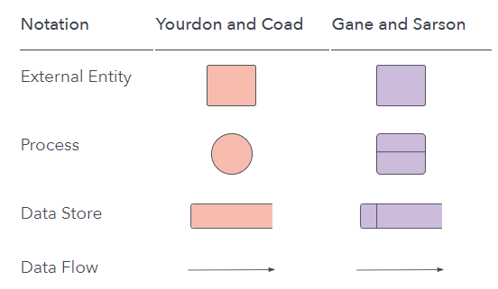
Symbols and Notations Used in DFDs
There are two models, Yourdon-Coad and Yourdon-DeMarco.

Slide 6
External entity
An outside system that sends or receives data, communicating with the system being diagrammed.
They might be an outside organization or person, a computer system or a business system.

Slide 7
Process
Any process that changes the data, producing an output. It might perform computations, or sort data based on logic, or direct the data flow based on business rules.
A short label is used to describe the process, such as “Submit payment.”

Slide 8
Data store
Files or repositories that hold information for later use, such as a database table or a membership form.
Each data store receives a simple label, such as “Orders.”

Slide 9
Data flow
The route that data takes between the external entities, processes and data stores.
Typically labeled with a short data name, like “Billing details.”

Slide 10
DFD rules and tips
Each process should have at least one input and an output.
Each data store should have at least one data flow in and one data flow out.
Data stored in a system must go through a process.
All processes in a DFD go to another process or a data store.

Slide 11
DFD levels and layers
A data flow diagram can dive into progressively more detail by using levels and layers, zeroing in on a particular piece.
DFD levels are numbered 0, 1 or 2, and occasionally go to even Level 3 or beyond.

Slide 12
DFD Context diagram(Level 0)
An abstract view of the system is represented using a context diagram.
The entire system is shown as a single process, labeled with the name of the system.
Context Diagram Can Contain:
One process(represents the entire system)
All External entities (data sources/sinks)
External data flows from/to external entities (inputs / outputs)

Slide 13
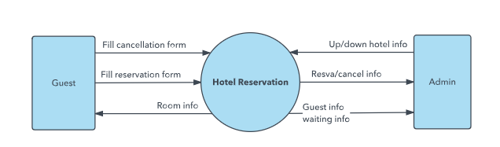
DFD Level 0(Context diagram)

Slide 14
DFD Level 1
DFD Level 1 provides a more detailed breakout of pieces of the Context Level Diagram.
You will highlight the main functions carried out by the system, as you break down the high-level process of the Context Diagram into its sub processes.

Slide 15
Drawing Level 1 DFD diagram
Identify major functions
Draw a Bubble for each process
Number processes(full numbers)
Too many processes i.e.> 7make the DFD difficult to understand
Identify the major data stores
Link them to the relevant processes
Balance the data flows with Context Diagram

Slide 16
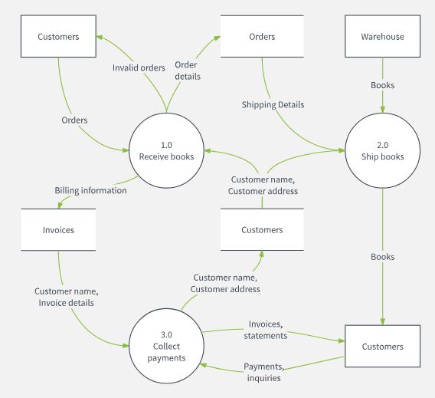
Level 1 DFD

Slide 17
Level 2 DFD
Identify processes that needs Decomposition(factoring/exploding)
When a process on the level-1 is Decomposed, it will be represented by a new Sub-Diagram (Level2) with more details.
Give decimal numbers to the processes in the sub diagrams
Balance the data flows (Level Balancing)

Slide 18
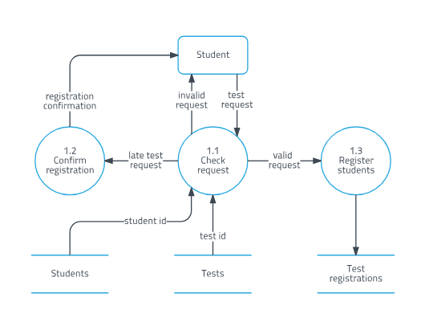
Level 2 DFD Decomposition

Slide 19
DFD vs. UML
While a DFD illustrates how data flows through a system, UML is a modeling language used in Object Oriented Software Design to provide a more detailed view.
A DFD may still provide a good starting point, but when actually developing the system, developers may turn to UML diagrams such as class diagrams

Slide 20
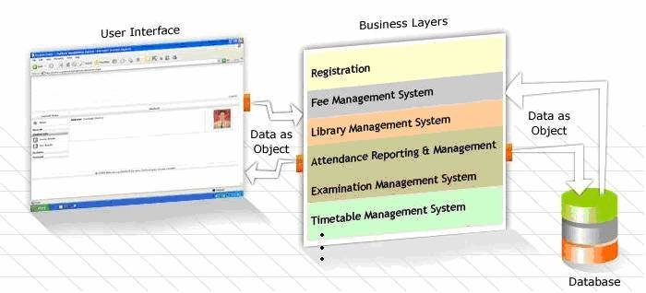
Why Database?
Database represent the data layers to system.

Slide 21
Database Design
Requirement analysis
Conceptual database design(ER diagram)
Schema refinement(Relational model)
Logical database design(Normalization)
Physical database design(SQL)
Security design (transactions)

Slide 22
Conceptual Database design(ER diagram)
ER diagrams are used to model and design relational databases, in terms of logic and business rules .
ER Diagrams are composed of entities, relationships and attributes.

Slide 23
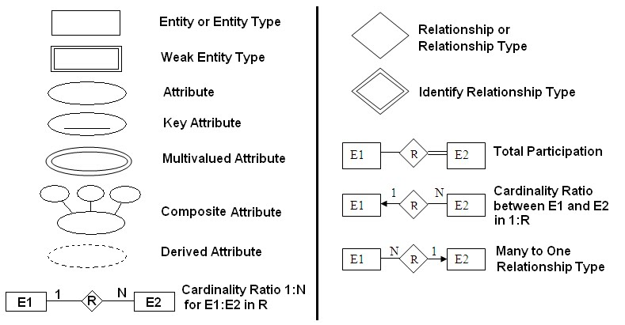
ER diagram symbols

Slide 24
How to draw a basic ER diagram
Identify the entities that are involved.
Identify the relationship among entities.
Identify the attributes of each entities including key attributes.
Show the cardinality ratio.

Slide 25
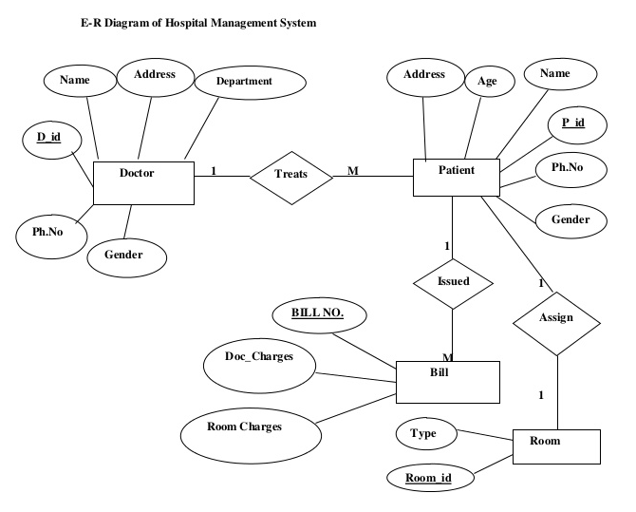
ER diagram example

Slide 26
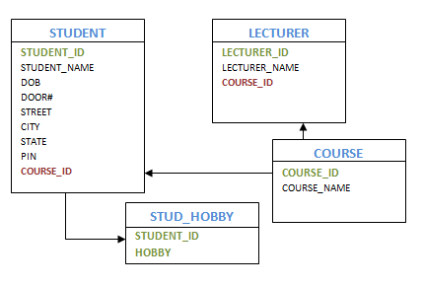
ERD to Relational model

Slide 27
User Interface Design
User Interface (UI) Design focuses on anticipating what users might need to do and ensuring that the interface has elements that are easy to access, understand, and use to facilitate those actions.

Slide 28
Choosing Interface Elements
Input Controls: buttons, text fields, checkboxes, radio buttons, dropdown lists, list boxes, toggles, date field
Navigational Components: breadcrumb, slider, search field, pagination, slider, tags, icons
Informational Components: tooltips, icons, progress bar, notifications, message boxes, modal windows
Containers: accordion

Slide 29
Best Practices for Designing an Interface
Keep the interface simple. The best interfaces are almost invisible to the user. They avoid unnecessary elements and are clear in the language they use on labels and in messaging.
Create consistency and use common UI elements. By using common elements in your UI, users feel more comfortable and are able to get things done more quickly.

Slide 30
Best Practices for Designing an Interface
Strategically use color and texture. You can direct attention toward or redirect attention away from items using color, light, contrast, and texture to your advantage.
Use typography to create hierarchy and clarity. Carefully consider how you use typeface. Different sizes, fonts, and arrangement of the text to help increase scanability, legibility and readability.

Slide 31

Using Light, Color and Contrast Effectively in UI Design
Light - create depth using light and shadow.
Think of a button. When a button is pressed, most designers tend to make it darker. Why? The reason is simple – we imagine the button as a 3D object.

Slide 32

Using Light, Color and Contrast Effectively in UI Design
Color - use heat to manage focus.
Yellow is warm and warmer colors are brighter. Not only that, they also appear closer to us.

Slide 33
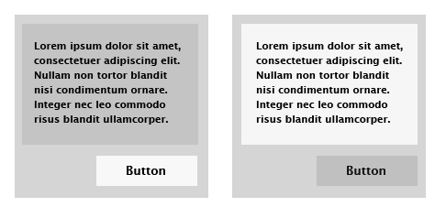
Using Light, Color and Contrast Effectively in UI Design
Contrast - attract attention with higher contrast. Higher contrast items stand out – they catch your eye.

Slide 34
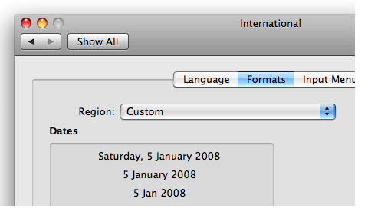
Example: The OS X interface
Let’s see a real world example of these principles from a well known usability expert – Apple.

Slide 35
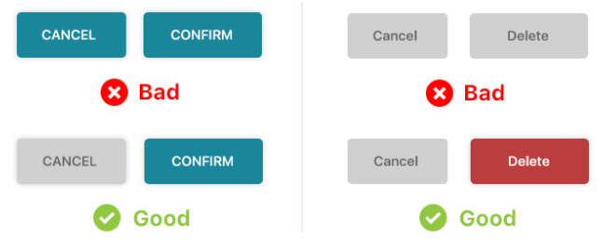
Examples: Good vs. Bad UI design
Priority

Slide 36
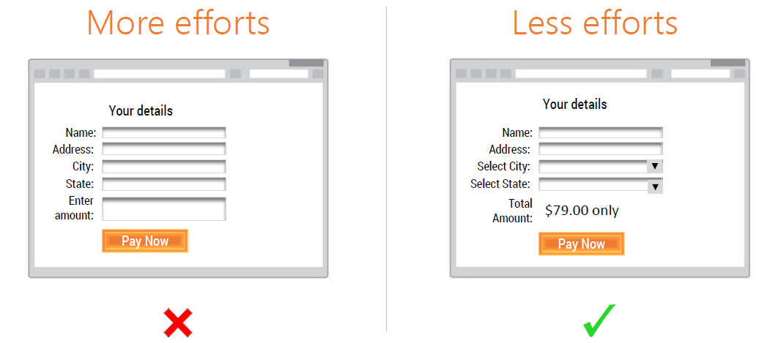
Examples: Good vs. Bad UI design
User effort

Slide 37
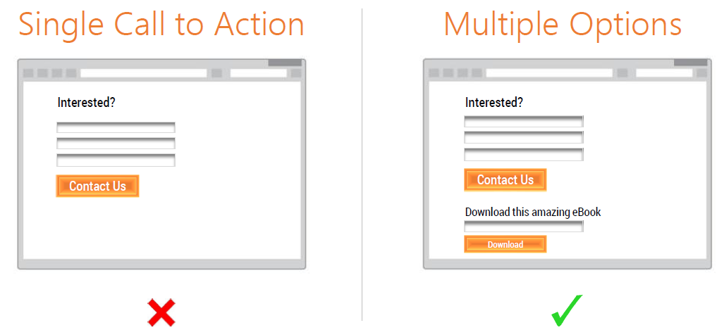
Examples: Good vs. Bad UI design

Slide 38
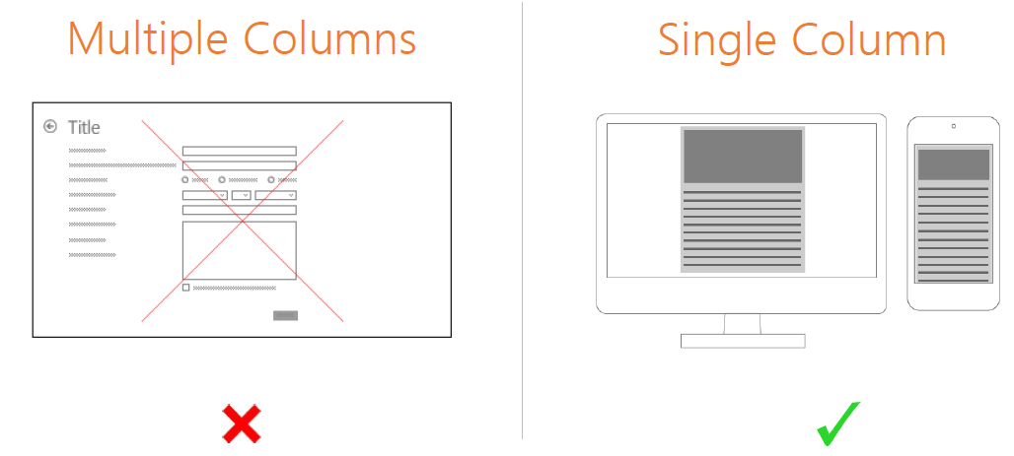
Examples: Good vs. Bad UI design

Slide 39
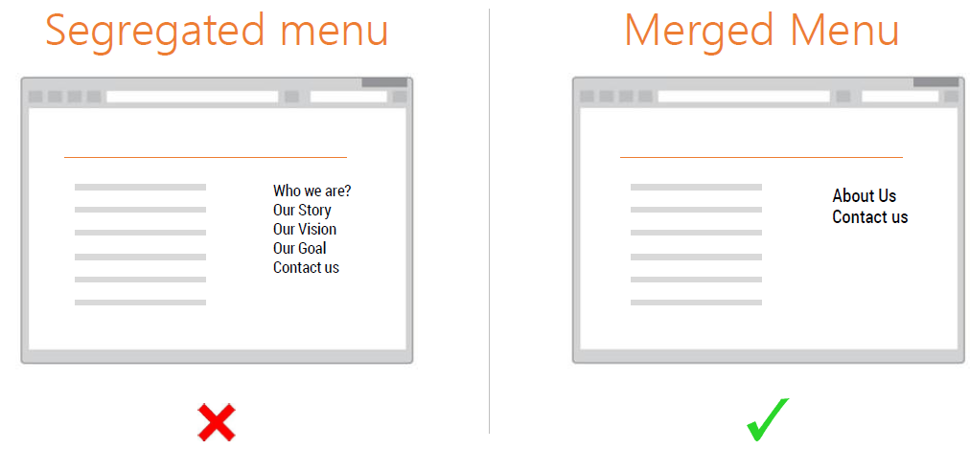
Examples: Good vs. Bad UI design

Slide 40
Key points
DFD is use to represent data flow between process.
ER diagram represent the conceptual model for the database.
User interface (UI) design is both an art and a science.

